Slide 1
HEMATOPOIETIC STEM CELL TRASPLANTATION
Dr. Ali Khazaal Jumaa
F.I.B.M.S (Int. Medicine) , F.I.B.M.S (hematology)

Slide 2
Definition :
Hematopoietic stem cell transplantation (HSCT) involves the intravenous infusion of autologous or allogeneic stem cells collected from bone marrow, peripheral blood, or umbilical cord blood to reestablish hematopoietic function in patients whose bone marrow or immune system is damaged or defective.

Slide 3
History
The starting point of HSCT may be traced to a 1939 report describing a patient who received 18 mL of bone marrow intravenously from his brother as treatment of aplastic anemia.
Following this report, major advances in transplantation science occurred in the 1950s. The following fundamental concepts of HSCT were discovered:
Barnes and Loutit’s observation of antileukemic and graft versus host disease effects of transplanted spleen cells in murine models
Thomas’ bone marrow transplantation in dogs using high-dose irradiation as conditioning
Dausset and Van Rood’s unraveling of the human leukocyte antigen (HLA) system.
These advances culminated in Thomas’ 1959 syngeneic bone marrow transplantation in 2 patients with acute lymphoblastic leukemia resulting in successful grafts.

Slide 4
Indications for HSCT
The indications for HSCT vary according to disease categories and are influenced by factors such as cytogenetic abnormalities, response to prior therapy, patient age and performance status, disease status (remission vs relapse), disease-specific prognostic factors, and, most importantly, availability of a suitable graft source, time of referral, and time to transplant.

Slide 5
Autologous HSCT
Multiple myeloma
Non-Hodgkin lymphoma
Hodgkin lymphoma
Acute myeloid leukemia M3 (APL)
Amyloidosis

Slide 6
Allogeneic HSCT
Acute myeloid leukemia, Acute lymphoblastic leukemia
Chronic myeloid leukemia, Chronic lymphocytic leukemia
Myeloproliferative disorders, Myelodysplastic syndromes
Non-Hodgkin lymphoma, Hodgkin lymphoma
Aplastic anemia, Pure red cell aplasia, Paroxysmal nocturnal hemoglobinuria
Thalassemia major, Sickle cell anemia

Slide 7
SOURCES OF HEMATOPOIETIC STEM CELLS
Bone marrow
Peripheral blood
Umbilical cord blood

Slide 8
Donor sources
. Patient himself
. Identical twin (syngeneic)
. Matched sibling
. Matched unrelated donor
. Haploidentical donor

Slide 10
Human leukocyte antigen
The human leukocyte antigen (HLA) system or complex is a gene complex encoding the major histocompatibility complex (MHC) proteins in humans. These cell-surface proteins are responsible for the regulation of the immune system in humans.
This genetic region has been divided into 3 classes:
Class I is made up of HLA-A, HLA-B, and HLA-C.
Class II is made up of HLA-DP, HLA-DQ and HLA-DR.
Class III encode components of the complement system.
Matching of HLA-A, HLA-B, HLA-C, HLA-DQ and HLA-DR is required for AlloSCT.

Slide 11
Conditioning Regimens for HSCT
. The conditioning regimen is a critical element in hematopoietic stem cell transplantation (HSCT). The purpose of the conditioning regimen is to provide immunosuppression sufficient to prevent rejection of the transplanted graft and to eradicate the disease for which the transplantation is being performed.
. These regimens can be classified as radiation-containing or non–radiation-containing regimens.

Slide 12
Complications of Allogeneic stem cell transplantation
. Graft failure
. Graft versus host disease
. Relapse
. Infections
. GIT toxicity (mucositis, pancreatitis, liver veno-occlusive disease,
biliary obstruction)
. Pulmonary complications (pulmonary edema, alveolar hemorrhage)
. Post-transplant lymphoproliferative disorders and secondary cancer
. Retarded growth
. Gonadal failure

Slide 13
Graft failure
It is a complex syndrome characterized by pancytopenia and hypocellular bone marrow. It may be manifested as either lack of initial engraftment if severe granulocytopenia persists for 28 days after transplantation (primary graft failure) or the development of pancytopenia and marrow aplasia after initial engraftment (late graft failure).
Risk factors: . Transplantation of low stem cell (CD34) cells
(more with umbilical cord graft)
. HLA disparity
. Others : infections, drugs

Slide 14
Graft vs Host Disease
. GVHD is an immune-mediated disease resulting from a complex interaction between donor and recipient adaptive immunity.
. Acute GVHD describes a distinctive syndrome of dermatitis, hepatitis, and enteritis developing within 100 days after allogeneic (HCT).
. Chronic GVHD describes a more diverse syndrome developing after day 100.
. The risk is more with peripheral blood than umbilical cord grafts, and with increased HLA disparity.

Slide 15
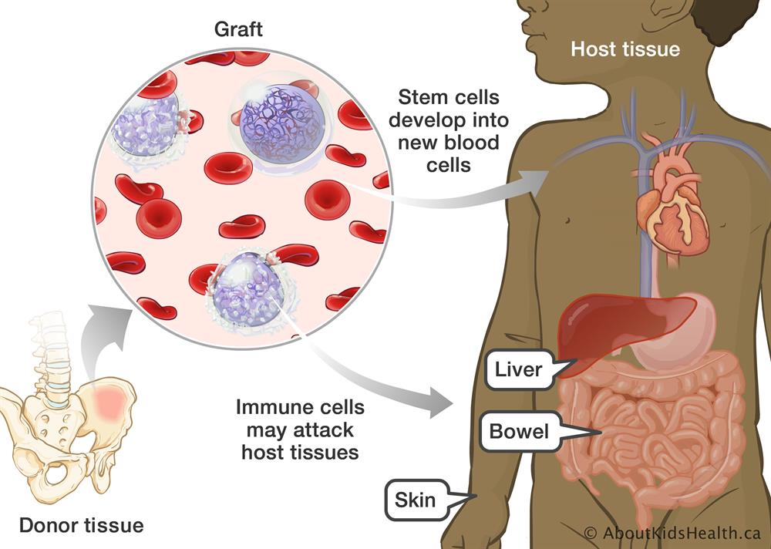

Slide 16
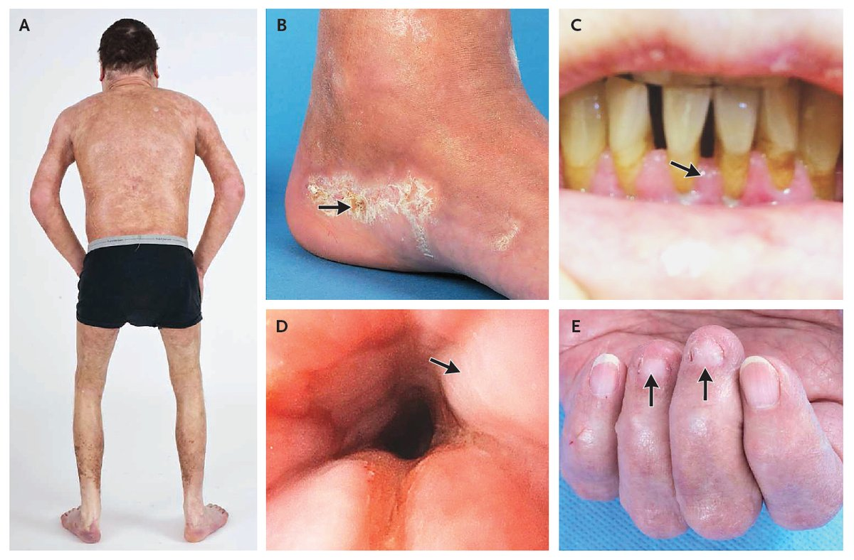
Chronic GvHD

Slide 17
Pathophysiology
. After bone marrow transplantation, T cells present in the graft attack the tissues of the recipient after perceiving host tissues as foreign.
. The T cells produce an excess of cytokines, including TNF-α and interferon-gamma (IFNγ).
. Graft-versus-host disease can occur even when HLA-identical siblings are the donors due to presence of genetically different proteins (called minor histocompatibility antigens).

Slide 18
. While donor T-cells are undesirable as effector cells of GVHD, they are valuable for engraftment by preventing the recipient's residual immune system from rejecting the bone marrow graft (host-versus-graft).
. In addition, donor T-cells have proven to have a valuable graft-versus-tumor effect.

Slide 19
Prevention
. More precise HLA matching between donors and transplant patients has been proven to reduce the incidence and severity of GvHD and to increase long-term survival.
. The T-cells of umbilical cord blood (UCB) have an inherent immunological immaturity, and the use of UCB stem cells in unrelated donor transplants has a reduced incidence and severity of GvHD.
. Methotrexate, cyclosporin and tacrolimus are common drugs used for GvHD prophylaxis.

Slide 20
Infections
. Many factors predispose to the development of infections in a transplant patient. Damage to the mucosal surfaces and skin from conditioning regimens and catheters, neutropenia and immunodeficiency from immunosuppressive medication and GVHD all contribute to this.
. Early after transplantation (0-30 days), mucosal and skin injury, as well as neutropenia, contribute to infections with aerobic bacteria (particularly coagulase-negative Staphylococcus species and viridans streptococci, gram-negative bacilli), Candida species, and herpes simplex.

Slide 21
. (1- 3 months) after transplantation, T-cell dysfunction, hypogammaglobulinemia, and acute GVHD predispose to infections with the following:
Encapsulated bacteria (eg, pneumococcus, Haemophilus influenzae)
Viruses (eg, cytomegalovirus)
Pneumocystis jiroveci
Molds (eg, Aspergillus)
Candida species.
. (3-12 months) after transplantation, slow T-cell reconstitution and chronic GVHD predispose patients to infections with encapsulated bacteria, cytomegalo virus, P jiroveci, and herpes zoster virus.

Slide 22
Complications of Autologous Stem Cell Transplantation
. Failure
. Infections
. GIT toxicity
. Pulmonary toxicity
. Gonadal failure
. Secondary MDS/AML
. Relapse

Slide 23
MCQs
1. Acute GVHD is mediated by:
a. Host T-cells
b. Donor T-cells
c. Host B-cells
d. Donor B-cells

Slide 24
2. Engraftment is defined as:
a. Absolute neutrophil count greater than 500/micl and a platelet count
greater than 20,000/micl
b. Absolute neutrophil count greater than 1000/micl and a platelet
count greater than 50,000/micl
c. Absolute neutrophil count greater than 500/micl and a platelet count
greater than 50,000/micl
d. Absolute neutrophil count greater than 1500/micl and a platelet
count greater than 20,000/micl
(A)

Slide 25
3- Which of these individuals might be considered as the optimal stem
cell donor for an adult patient with high risk acute myeloid leukaemia in first
remission?
a. An identical twin
b. A cord blood stem cell donation
c. An HLA matched unrelated donor
d. An HLA matched sibling donor
e. Any of the above
(D)
An HLA matched sibling donor would offer the optimal degree of alloreactive mismatch to allow development of a degree of graft-versus-leukaemia (graft vs tumor) which is likely to be required to cure cases of relapsed acute leukaemia.

